Slide 1

Door Access Control System
Junqing Zhao

Slide 2
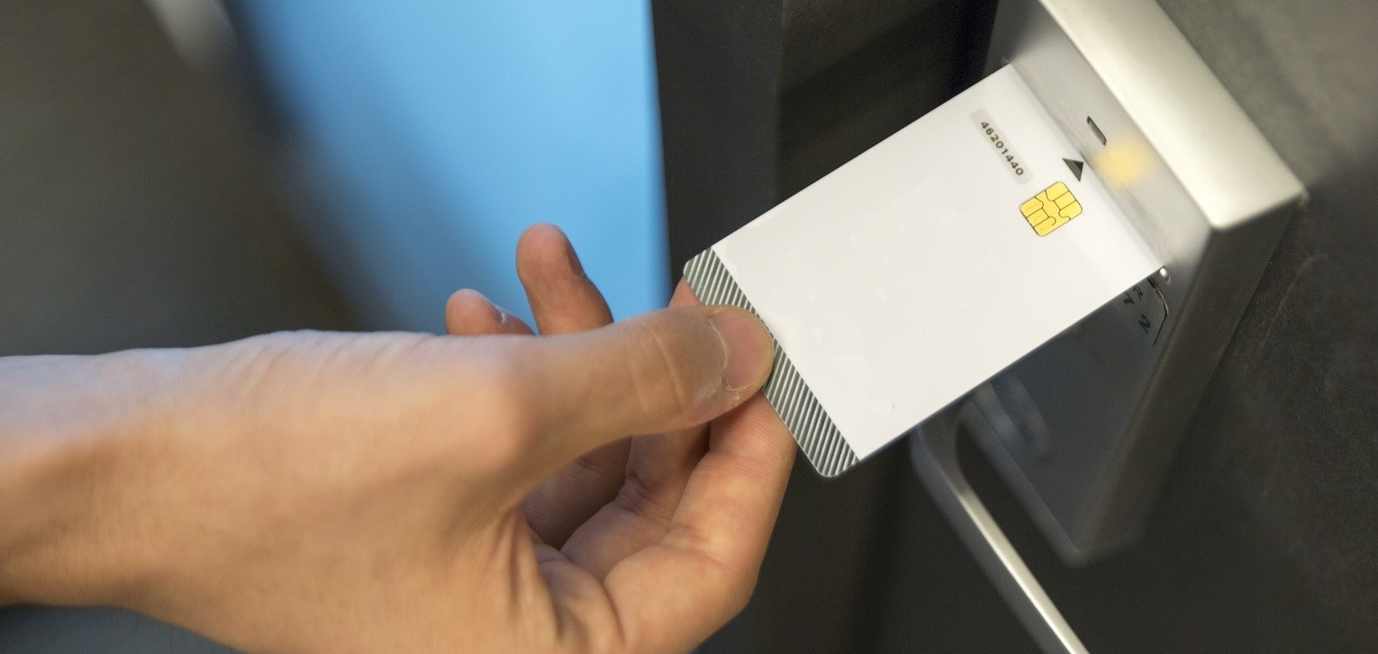

Where and What It Built For
Only authorize access allowed
Financial dept. (Bank)
Military
Personal security

Slide 3

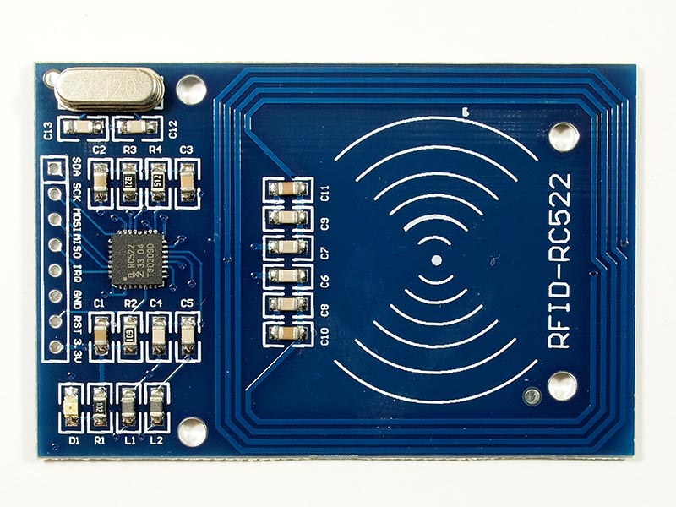
How It built
Magnetic Relay
MFRC 522-RFID reader

Slide 4
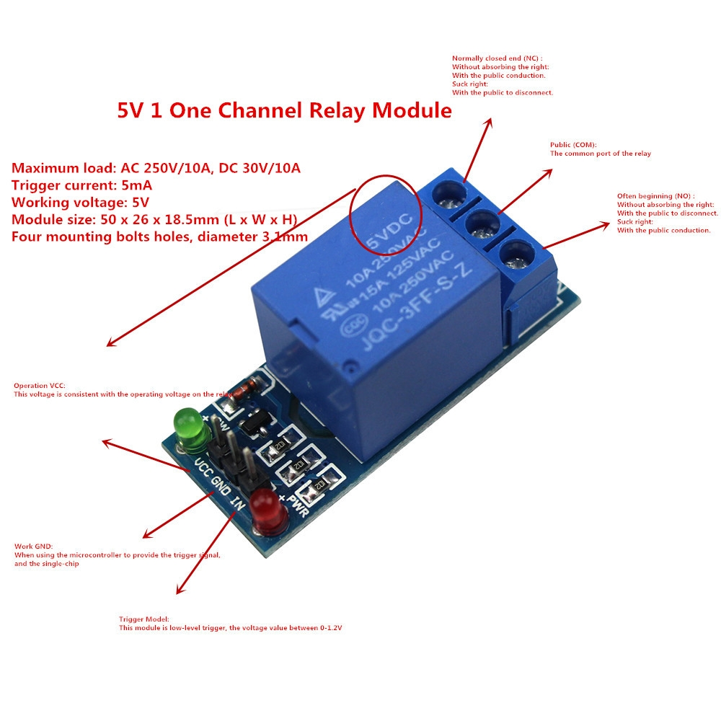
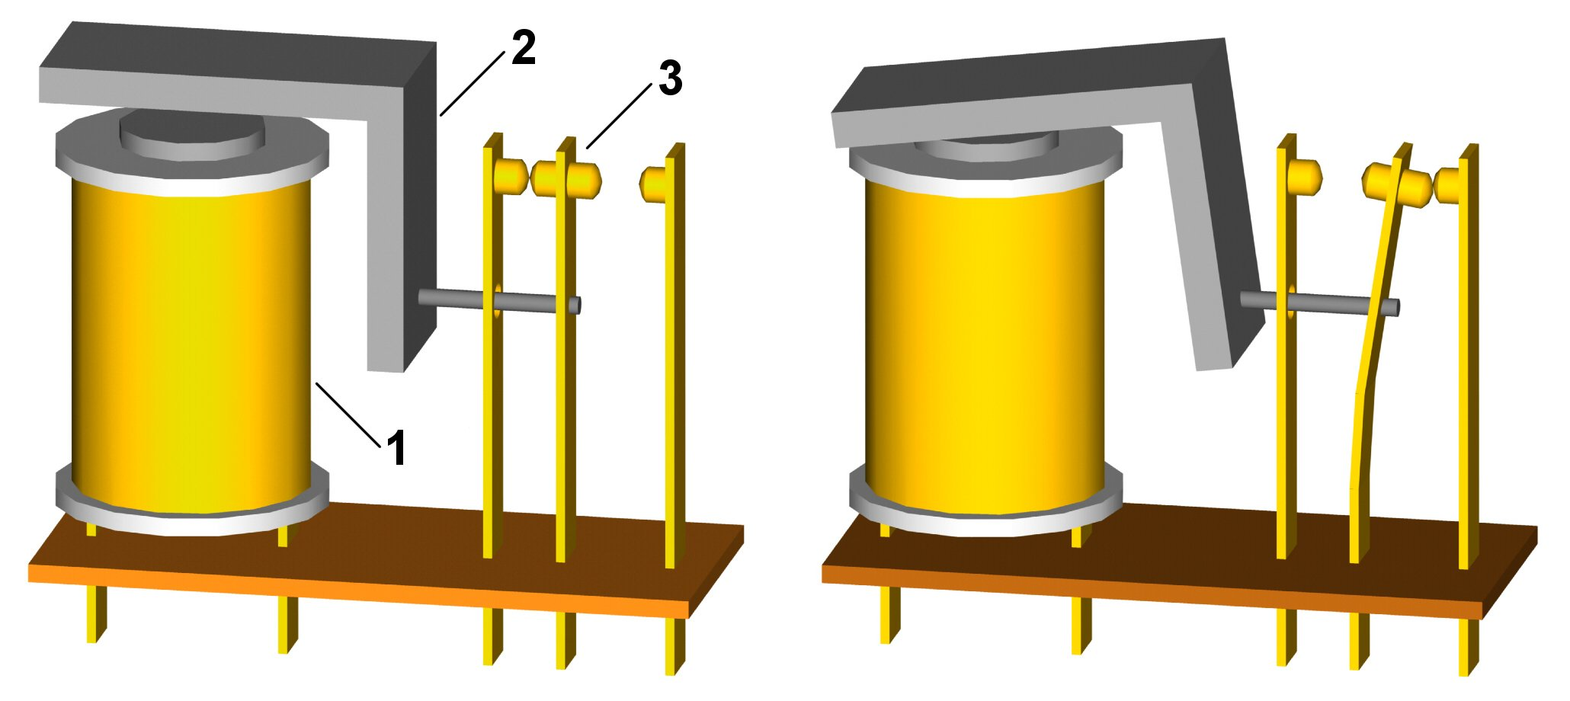
How It built
Magnetic Relay
Magnetic Relay

Slide 5
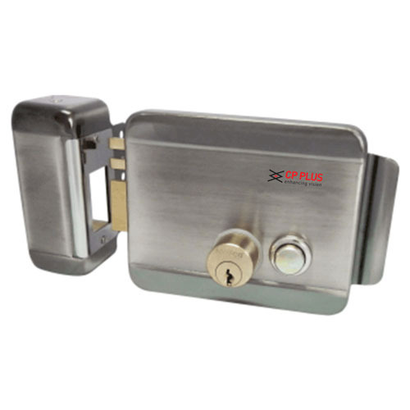
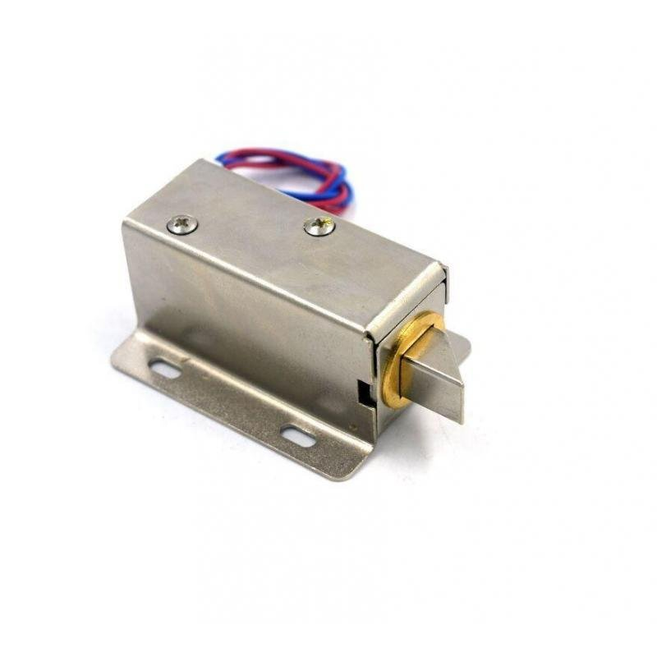
How It built
Magnetic Relay
Electric door lock

Slide 6
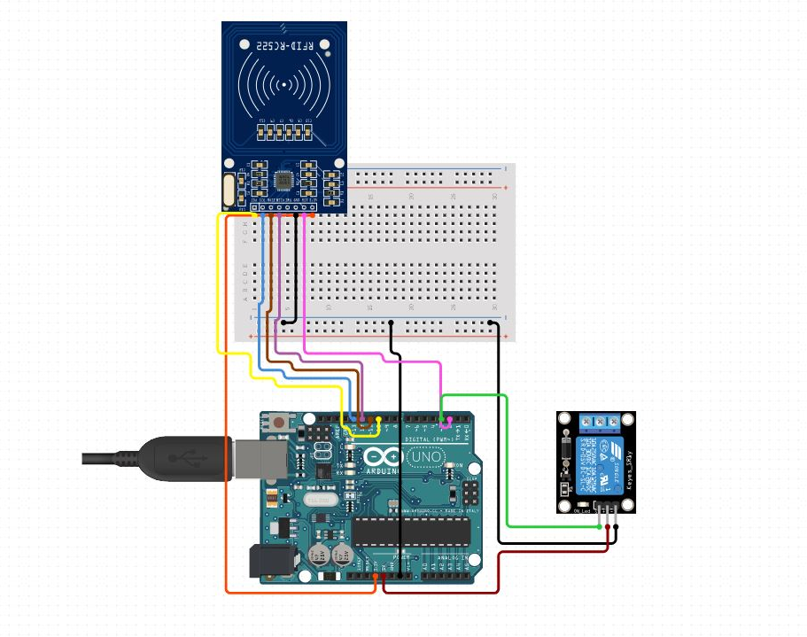

Slide 7
Price
Arduino UNO R3 : $25
MFRC 522 reader : $15
Channel Relay module : $5.99
Heavy duty electric door lock : $50
Blank pvc IC cards: $1.99
Some jump wires: $1
Total: $98.98

